Slide 1
Blinkit : India’s Last Mintue app

Slide 2
Project Overview:
Objective: To analyze Blinkit's item sales performance across different outlet types, sizes, and geographic tiers in order to uncover insights that can help optimize product placement, outlet operations, and customer targeting strategies.
Business Context: Blinkit is a quick commerce platform serving diverse customer segments across India. With rapid expansion into Tier 2 and Tier 3 cities, understanding sales trends at a granular level is critical for supply chain, merchandising, and marketing decisions.
Key Goals:
Evaluate sales trends by item type, fat content, and outlet characteristics.
Identify high-performing outlet types, sizes, and locations.
Understand how visibility, item count, and ratings affect performance.
Leverage BI tools and programming to automate reporting and enhance data storytelling.
Outcome: A dynamic dashboard (built using Power BI) with filterable views and performance KPIs, supported by Python, SQL, Excel, and Tableau for data prep, analysis, and visualization.

Slide 3
🛠️ Tools & Technologies Used :
Tool | Usage Description
SQL | Data extraction, transformation, filtering outlet/item information
Excel | Initial data cleaning, pivot tables for quick summaries
Power BI | Interactive dashboard with filters, charts, and KPIs
Tableau | (Optional) Exploratory visualizations to compare insights
Python | Report automation and PDF generation, data manipulation (Pandas

Slide 4
📈 Insights & Visualizations :
This section summarizes key findings derived from the Power BI dashboard, supported by data exploration in Tableau and Python. The dashboard allowed dynamic filtering by outlet type, size, location tier, and item characteristics.
✅ Key Insights:
Tier 3 outlets generate the highest sales ($472K), showing strong demand in semi-urban and rural areas.
Fruits and Snacks are the top-performing categories, each contributing close to $200K in revenue.
High-sized outlets account for 42.3% of total sales, suggesting that larger formats attract more customers and have more inventory.
Regular fat items lead with 64.6% of total item sales, while low-fat items represent a smaller but notable share.
Supermarket Type 1 and Grocery Stores outperform others, despite differences in item count and visibility.
Sales in Tier 1 cities are the lowest ($336K), indicating possible market saturation or competition.
Outlet visibility has a direct impact on item sales, especially in Supermarket Type 1 outlets.
Outlet establishment dipped in 2010, but has remained consistent post-2015, showing stable growth.
Categories like Seafood and Breakfast have lower sales, highlighting potential areas for marketing or inventory review.
Item sales follow the 80/20 rule, where a few categories drive most of the revenue.

Slide 5
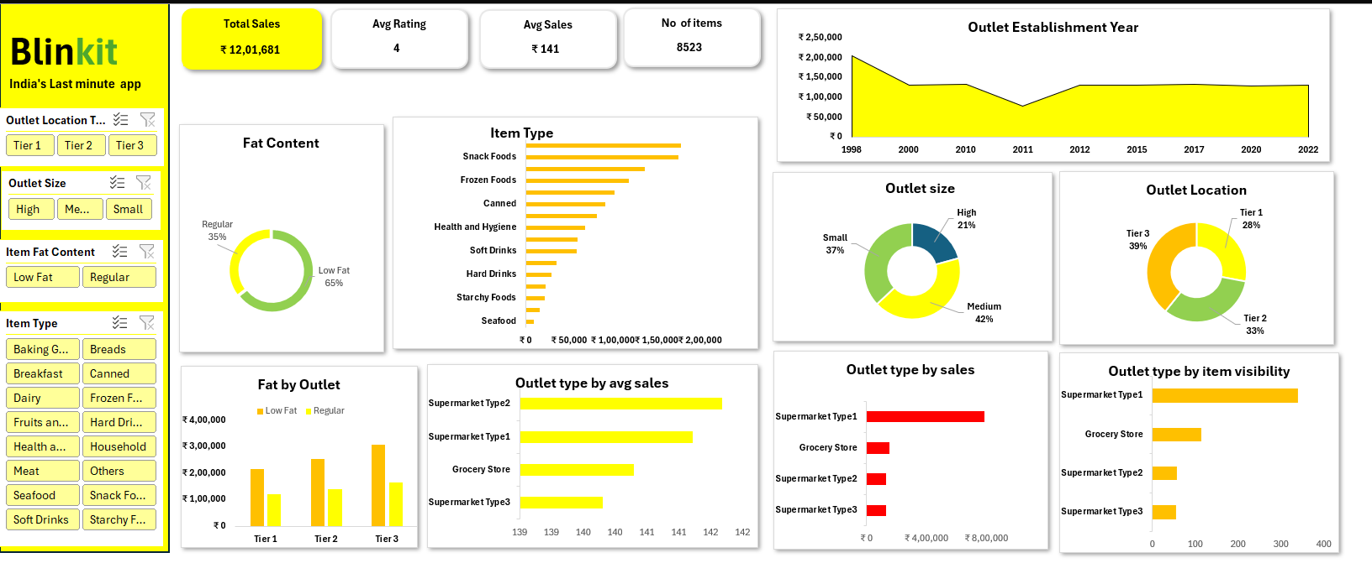
Excel dashboard :

Slide 6
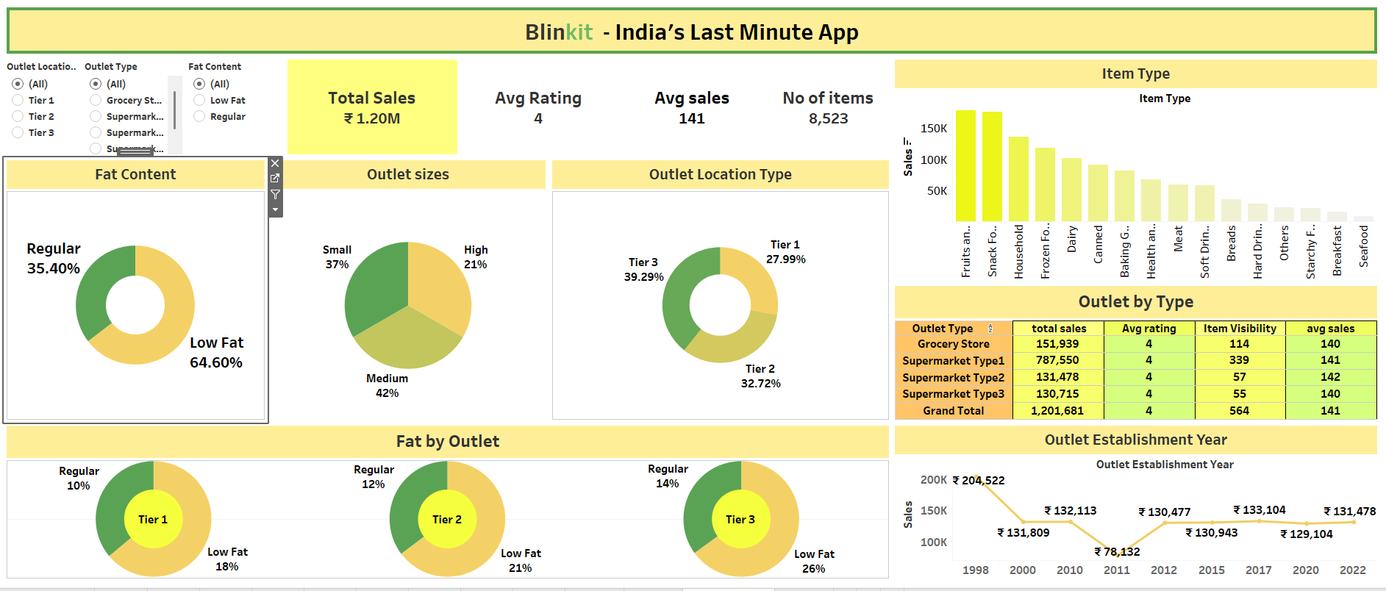
Tableua Dashboard:

Slide 7
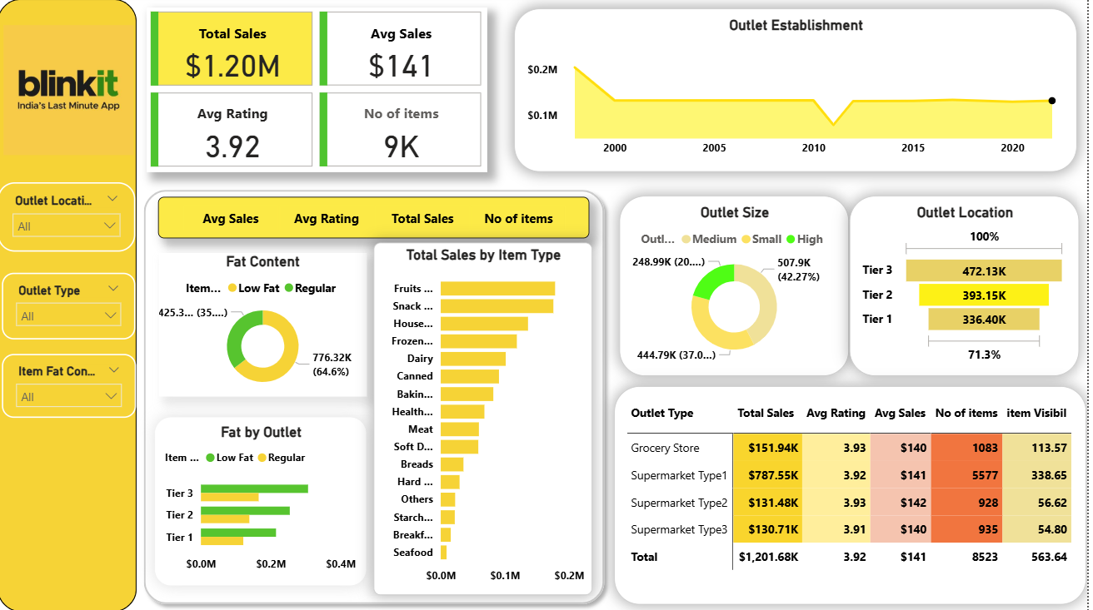
Powerbi dashboard:

Slide 8
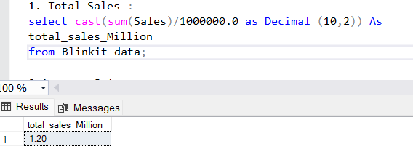
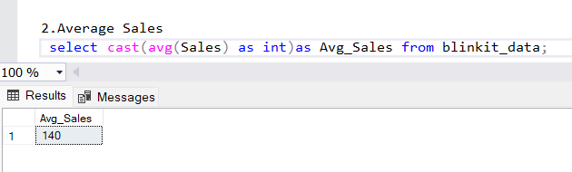
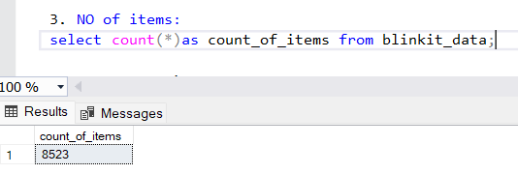
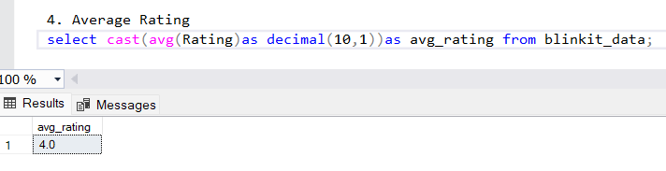
SQl Queries :

Slide 9
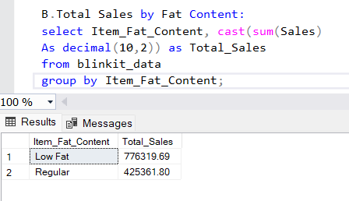
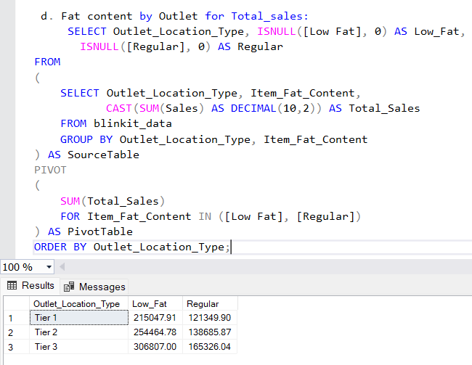
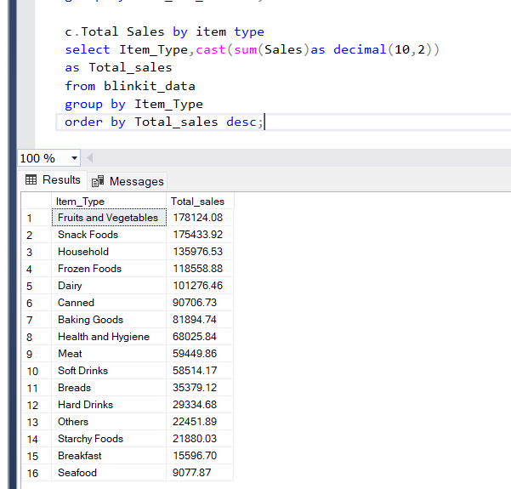

Slide 10
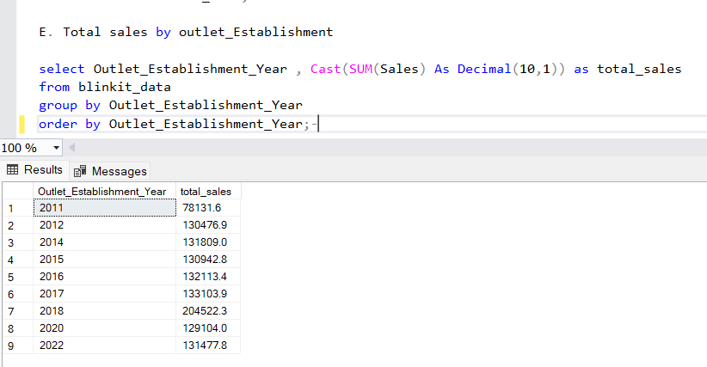
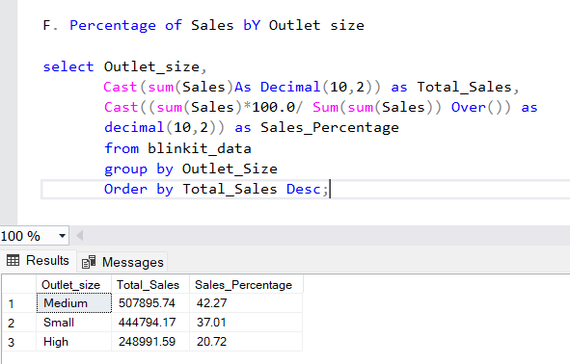
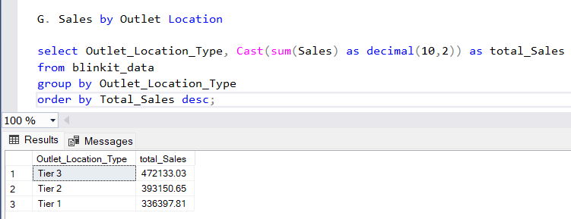
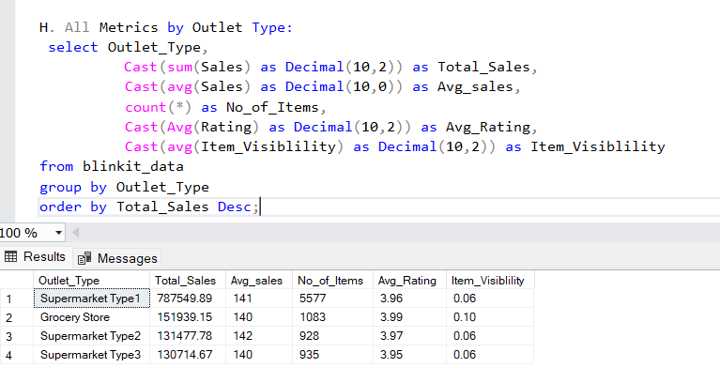

Slide 11
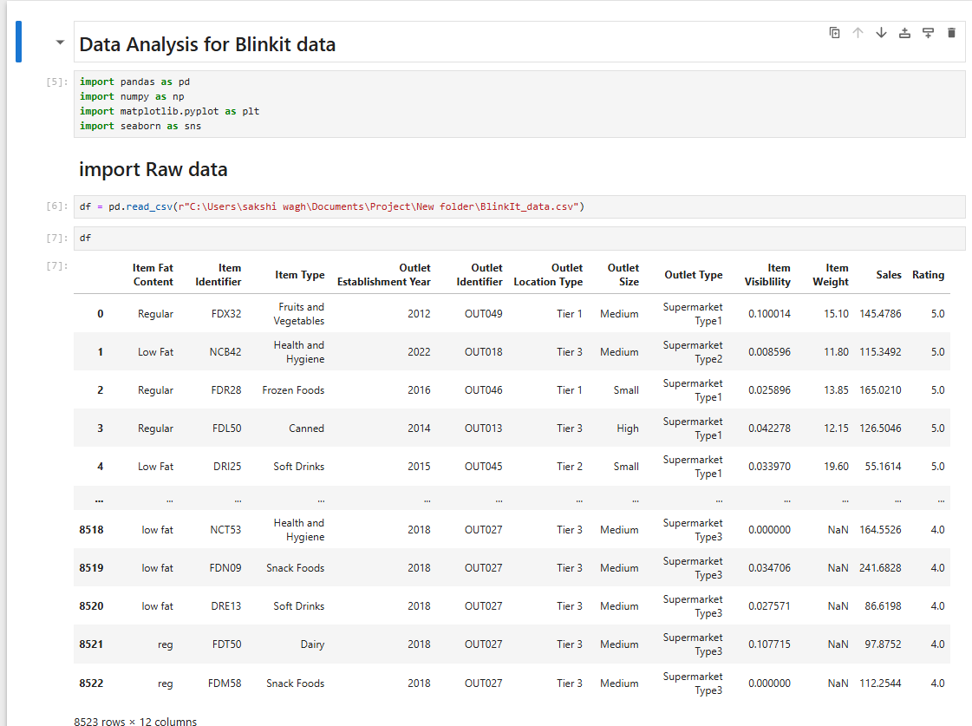
Python :

Slide 12
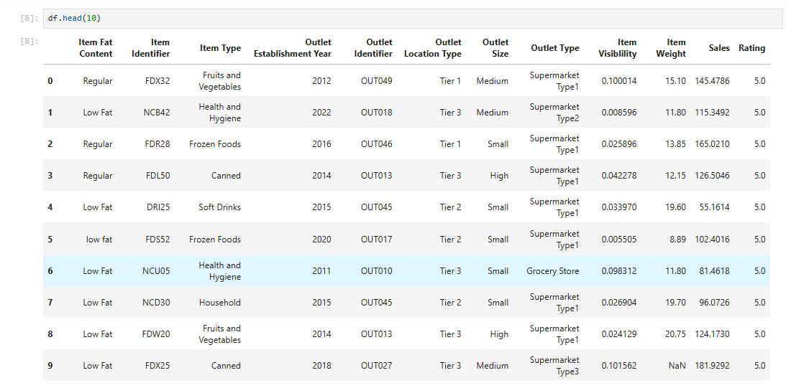

Slide 13
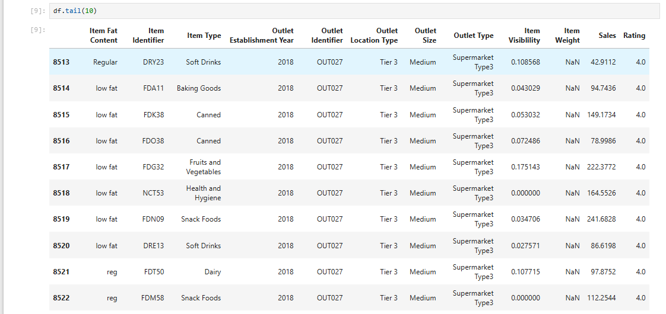

Slide 14
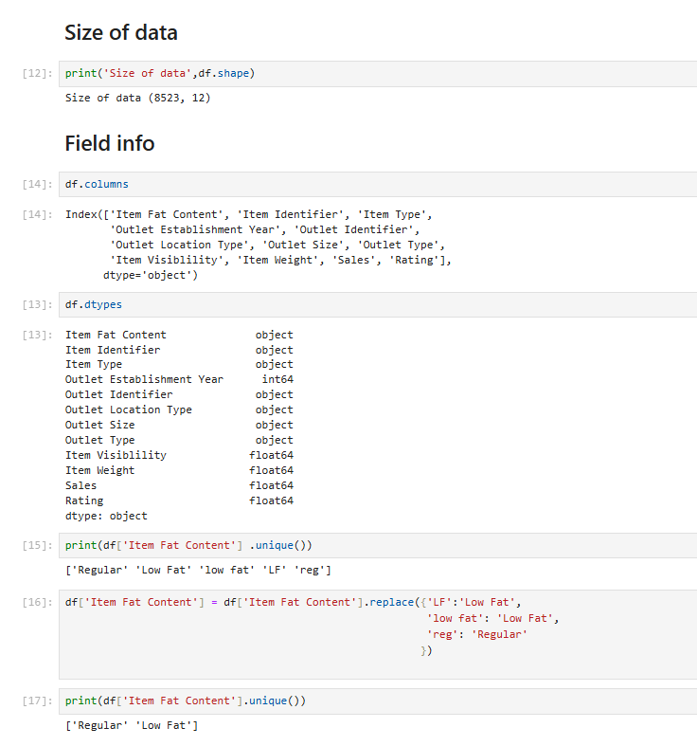
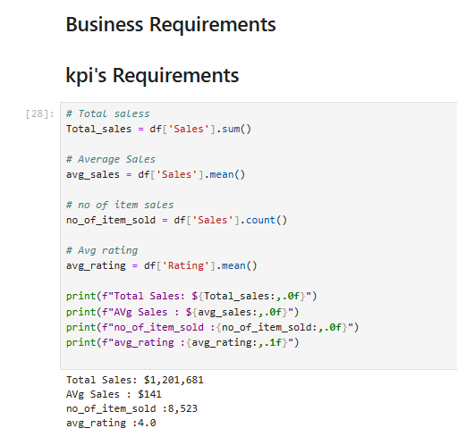

Slide 15
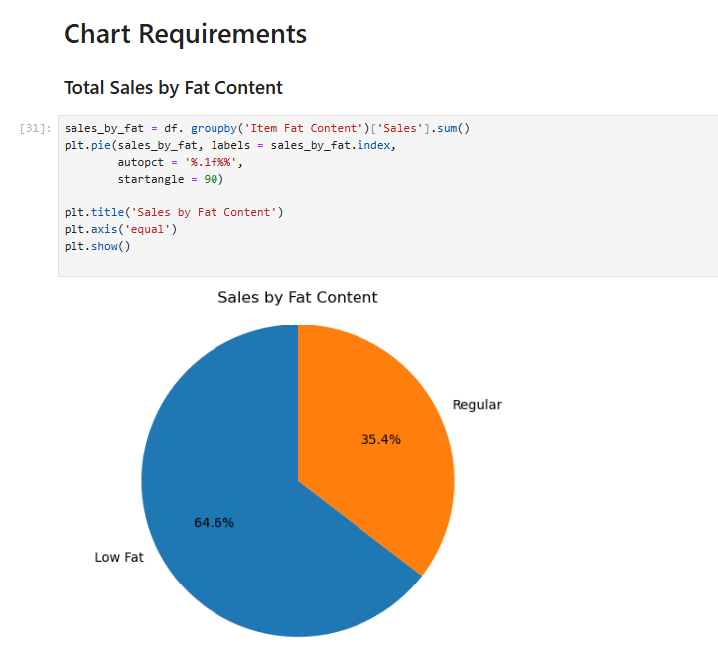
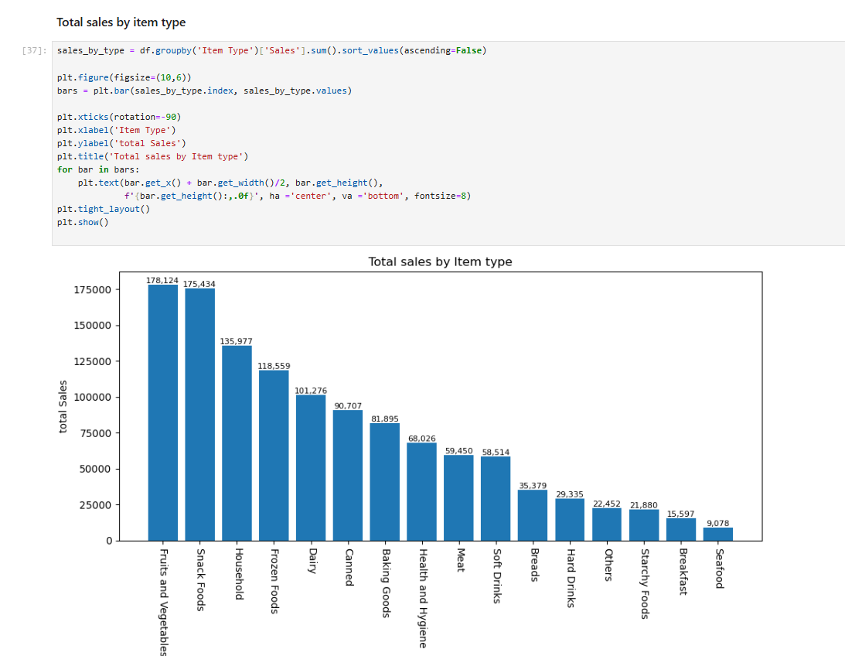

Slide 16
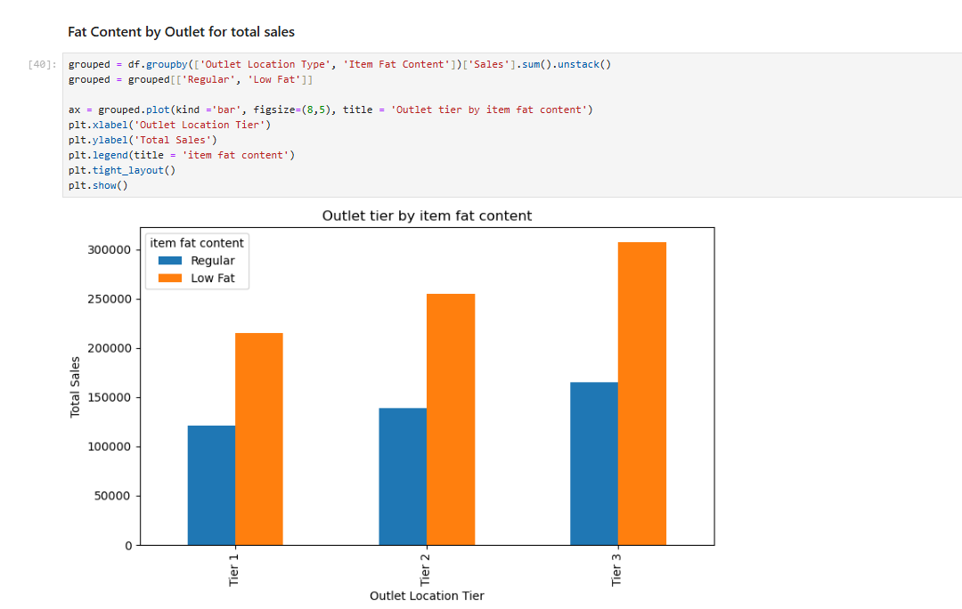
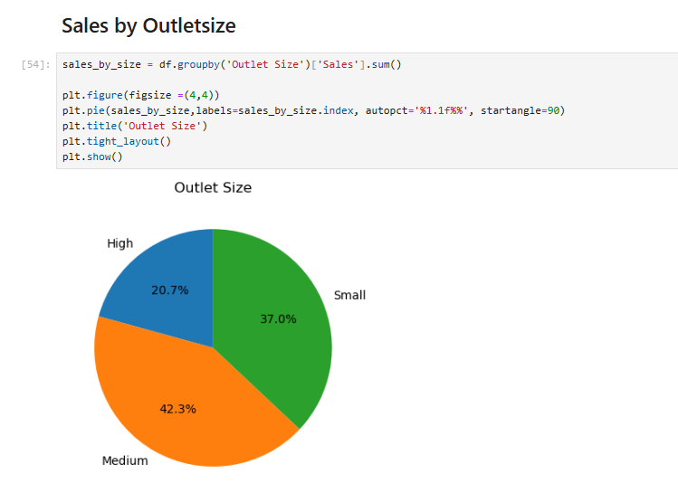

Slide 17
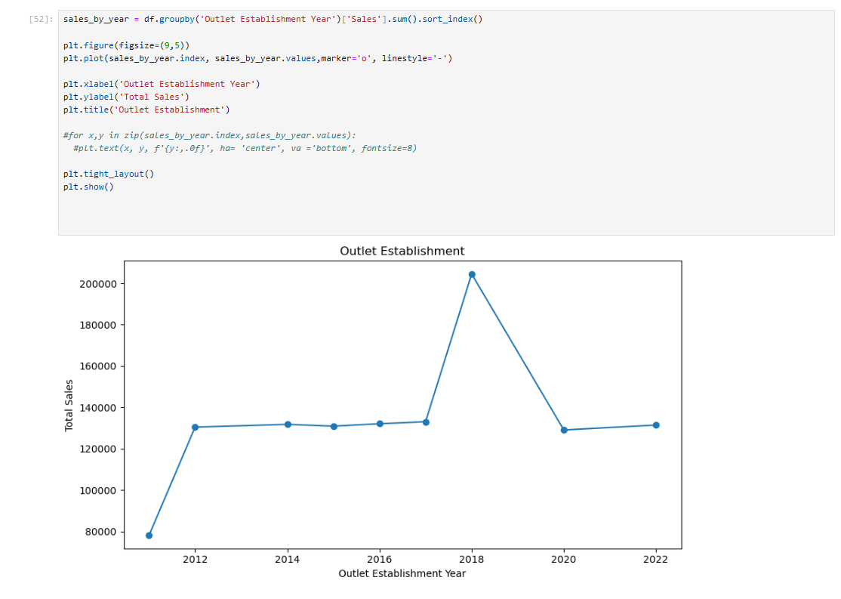

Slide 18
